Slide 1
GORG Classifier
Greg Gavelis, Ramunas Stepanauskas, Joe Brown
GORG Dark Jamboree
Thursday April 4, 2024

Slide 2
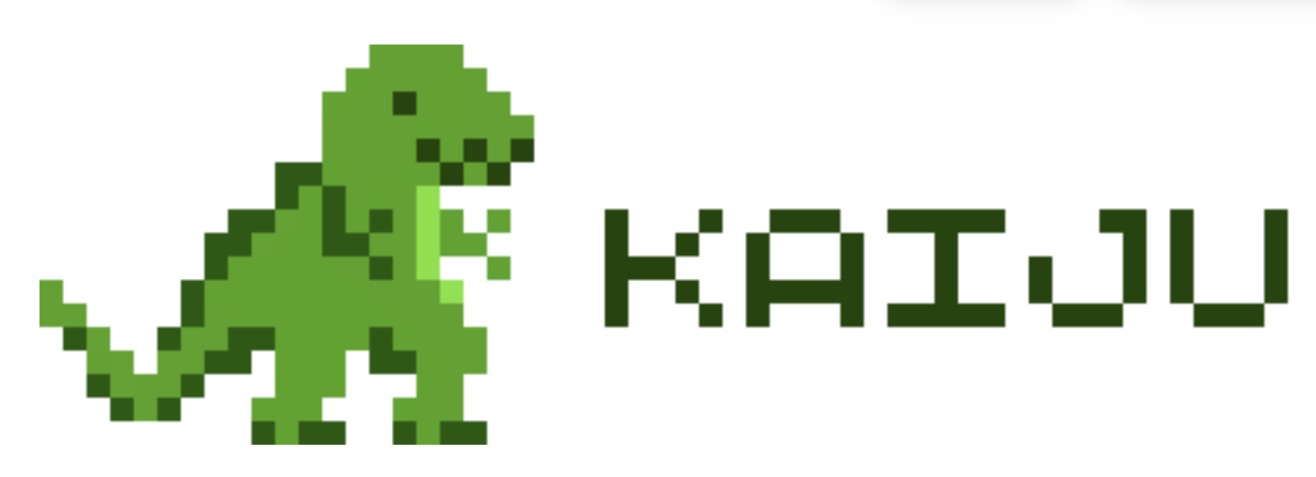
Goal of Kaiju & Kraken
"One of the major biological questions in metagenomics is the inference of the composition of a microbial community, that is, the relative abundances of the sampled organisms.”
i.e. Who are the organisms in this sample?
Also:
What functions do these genes encode?

Slide 3
How Kraken & Kaiju work (Broadly)
Maps:
Reads to reference proteins (A -> B)
Proteins to the reference organism’s (NCBI) taxon (B -> C)
Achieves very fast mapping or reads to taxa. (A -> C)

Slide 4
How Kraken & Kaiju work (Broadly)
Maps:
Reads to ref proteins (A -> B)
Ref proteins to ref organism’s NCBI taxon (B -> C)
Achieves very fast mapping or reads to taxa.
How? Doesn’t rely on local alignment. Uses exact alignment to kmers from the reference proteins.

Slide 5
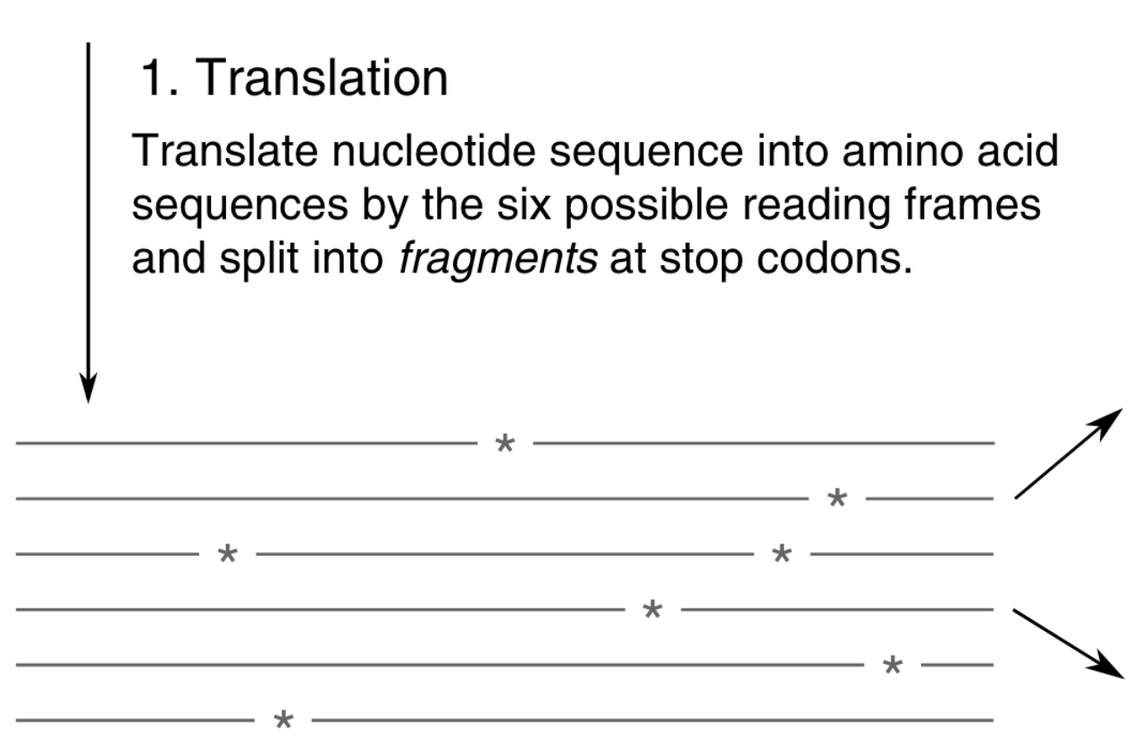
Kaiiju read mapping algorithm
For each read…

Slide 6
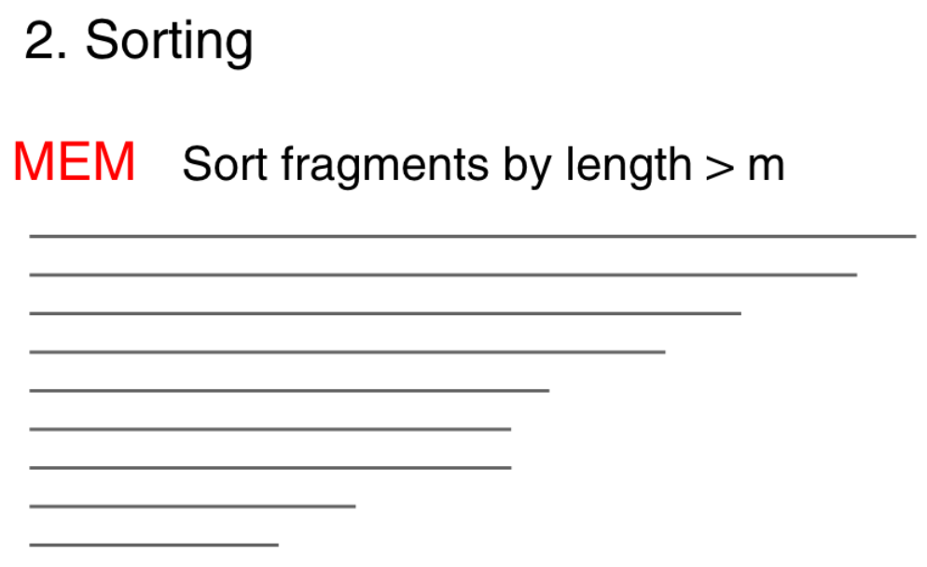
Kaiiju read mapping algorithm
For each read…

Slide 7
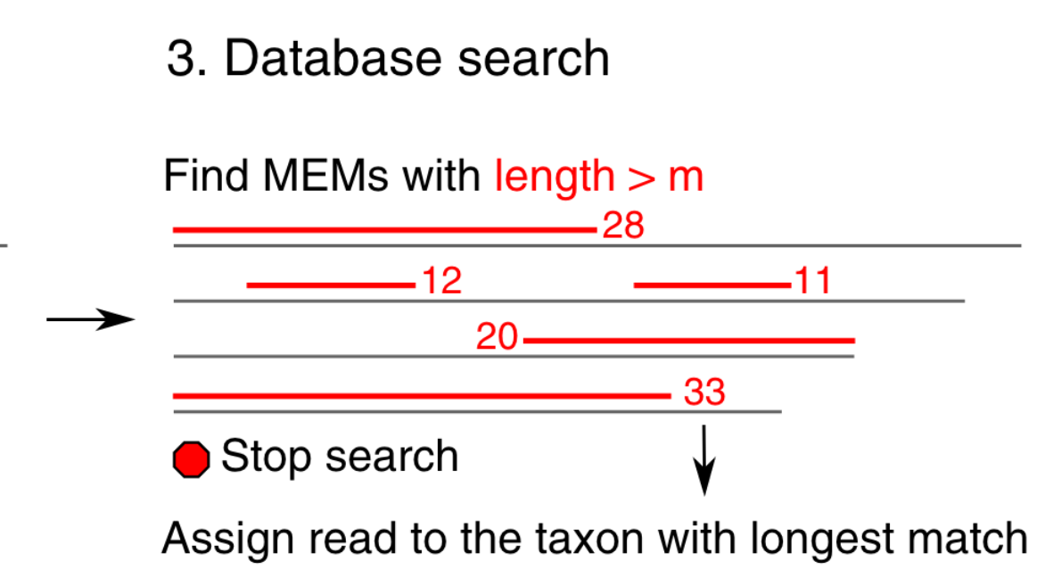
Kaiiju read mapping algorithm
For each read… looks for exact AA match of length k
Aligns kmers

Slide 8
Kaiiju read mapping algorithm
For each read… looks for exact AA match of length k
Aligns kmers

Slide 9
Kaiiju read mapping algorithm
For each read… looks for exact AA match of length k
Aligns kmers
What happens if two reference genomes both have an equally good kmer match?

Slide 10
Kaiiju read mapping algorithm
For each read… looks for exact AA match of length k
Aligns kmers
What happens if two reference genomes both have an equally good kmer match?
Kaiju goes higher in the tree to the last common ancestor (LCA) with that kmer. Assigns the read to that ancestor.

Slide 11
Kaiiju read mapping algorithm
For each read… looks for exact AA match of length k
Aligns kmers
What happens if two reference genomes both have an equally good kmer match?
Kaiju goes higher in the tree to the last common ancestor (LCA) with that kmer. Assigns the read to that ancestor.
Note: Kaiju’s innovation is using variable kmer lengths (Kraken uses fixed length). Kaiju first attempts 63AA exact matches, but retries down to 7AA if necessary

Slide 12
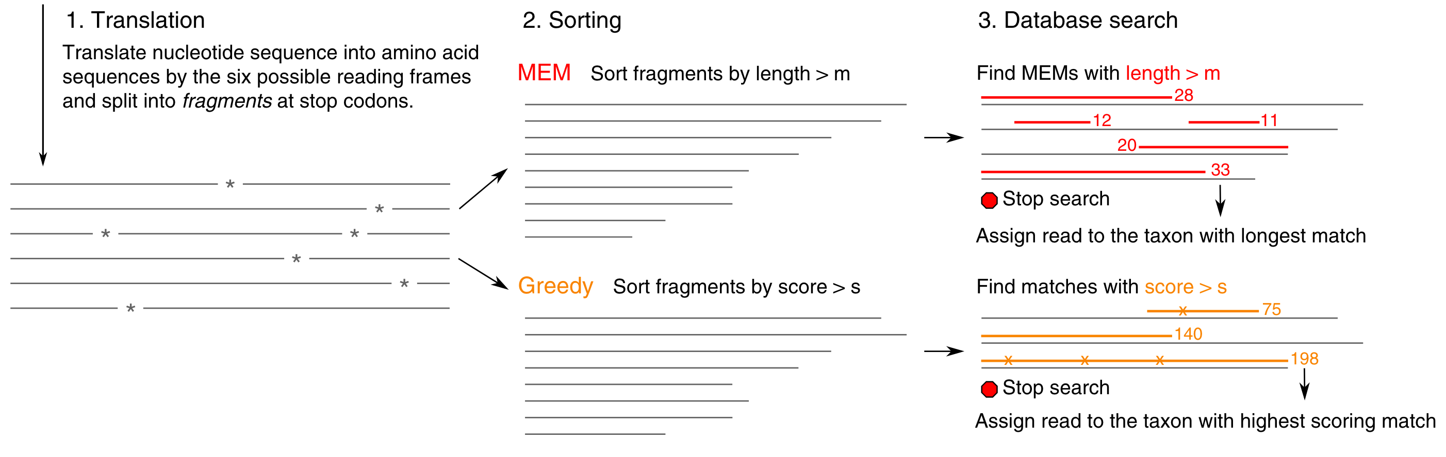
Kaiiju also allows mismatches at end of kmers
“greedy mode” (what we use)

Slide 13
So Kraken & Kaiju are built on...
1. Protein alignment software:
Burrough’s Wheeler Aligner
2. A taxonomic framework for those reference taxa
NCBI taxonomy
3. A reference protein databases:
NCBI’s nr (just the microbes)
OR
Refseq

Slide 14
So Kraken & Kaiju are built on...
1. Protein alignment software:
Burrough’s Wheeler Aligner
2. A taxonomic framework for those reference taxa
NCBI taxonomy
3. A reference protein databases:
NCBI’s nr (just the microbes)
OR
Refseq
A tool is only as good as its reference databases!

Slide 15


Advantages of GORG classifier, pt. I
Coded by Joe Brown
1. Recruits to more taxonomically diverse references:
GORG-Tropics (~8000 classified SAGs)
--integrated by Joe ~2019
GORG-Dark (> 9000 classified SAGs)
--integrated by me
Notes:
Each sample gets its own namesake folder. That folder contains the final genome assembly (e.g. AH-141-C18_contigs.fasta), and also three directories, where the products of varies pipeline steps are deposited. (Note that we don’t include all of the intermediates from read processing, since fastq files are very large.)

Slide 16
Advantages of GORG classifier, pt. I
Coded by Joe Brown
1. Recruits to more taxonomically diverse references:
GORG-Tropics (~8000 classified SAGs)
--integrated by Joe ~2019
GORG-Dark (> 9000 classified SAGs)
--integrated by me
2. Within an improved taxonomic framework
NCBI taxonomy has massive blind spots and biases.
So GORG-Dark classifier uses GTDB taxonomy. (<- names.dmp & nodes.dmp)
Notes:
Each sample gets its own namesake folder. That folder contains the final genome assembly (e.g. AH-141-C18_contigs.fasta), and also three directories, where the products of varies pipeline steps are deposited. (Note that we don’t include all of the intermediates from read processing, since fastq files are very large.)

Slide 17
Advantages of GORG classifier, pt. I
Coded by Joe Brown
1. Recruits to more taxonomically diverse references:
GORG-Tropics (~8000 classified SAGs)
--integrated by Joe ~2019
GORG-Dark (> 9000 classified SAGs)
--integrated by me
2. Within an improved taxonomic framework
NCBI taxonomy has massive blind spots and biases.
So GORG-Dark classifier uses GTDB taxonomy. (<- names.dmp & nodes.dmp)
Currently GORG-tropics still uses ncbi taxonomy
Eventually we should re-release it w/ GTDB
Notes:
Each sample gets its own namesake folder. That folder contains the final genome assembly (e.g. AH-141-C18_contigs.fasta), and also three directories, where the products of varies pipeline steps are deposited. (Note that we don’t include all of the intermediates from read processing, since fastq files are very large.)

Slide 18
Advantages of GORG classifier, pt. II
Coded by Joe Brown
3. Biggest innovation (by Joe).
Also maps reads to functions!
(annotations by KEGG, Swissprot, CAZy, etc.)
Notes:
Each sample gets its own namesake folder. That folder contains the final genome assembly (e.g. AH-141-C18_contigs.fasta), and also three directories, where the products of varies pipeline steps are deposited. (Note that we don’t include all of the intermediates from read processing, since fastq files are very large.)

Slide 19
Advantages of GORG classifier, pt. II
Coded by Joe Brown
3. Biggest innovation (by Joe).
Also maps reads to functions!
(annotations by KEGG, Swissprot, CAZy, etc.)
So we can ask:
Who are the organisms in this sample and what are they doing?
Notes:
Each sample gets its own namesake folder. That folder contains the final genome assembly (e.g. AH-141-C18_contigs.fasta), and also three directories, where the products of varies pipeline steps are deposited. (Note that we don’t include all of the intermediates from read processing, since fastq files are very large.)

Slide 20
Advantages of GORG classifier, pt. II
Coded by Joe Brown
3. Biggest innovation (by Joe).
Also maps reads to functions!
(annotations by KEGG, Swissprot, CAZy, etc.)
So we can ask:
Who are the organisms in this sample and what are they doing?
For metagenomics: Which taxa are in the sample and what is their metabolic potential?
For metatranscriptomes: Which taxa are in the sample and what are they expressing?
Notes:
Each sample gets its own namesake folder. That folder contains the final genome assembly (e.g. AH-141-C18_contigs.fasta), and also three directories, where the products of varies pipeline steps are deposited. (Note that we don’t include all of the intermediates from read processing, since fastq files are very large.)

Slide 21
How does GORG classifier work?
It’s a pipeline built on Kaiju
Runs Kaiju with:
new reference DB (proteins from GORG Dark or Tropics)
modified taxonomy (GTDB for Dark)
After Kaiju, runs extra steps to incorporate annotations
Output: A recruitment table -> {ID}_annotations.txt.gz
Massive, 1 row per read.

Slide 22
How does GORG classifier work?
It’s a pipeline built on Kaiju
Runs Kaiju with:
new reference DB (proteins from GORG Dark or Tropics) <- index.fmi
modified taxonomy (GTDB for Dark) <- names.dmp & nodes.dmp
After Kaiju, runs extra steps to incorporate annotations. <- annotations.tsv
Output: A recruitment table -> {ID}_annotations.txt.gz
Massive, 1 row per read.

Slide 23
To run GORG classifier, pt. I
Program files
Index.fmi, names.dmp, nodes.dmp, annotations.tsv

Slide 24
To run GORG classifier, pt. I
Program files
Index.fmi, names.dmp, nodes.dmp, annotations.tsv
Your read files to analyze
E.g. {ID}_R1.fq.gz & {ID}_R2.fq.gz
Metagenomic or metatranscriptomic. Paired or unpaired. Zipped or unzipped.

Slide 25
To run GORG classifier, pt. I
Program files
Index.fmi, names.dmp, nodes.dmp, annotations.tsv
Your read files to analyze
E.g. {ID}_R1.fq.gz & {ID}_R2.fq.gz
Metagenomic or metatranscriptomic. Paired or unpaired. Zipped or unzipped.
Software dependencies
Nextflow ( including nextflow.config file) = Runs bioinf pipelines
Singularity (on cluster) or Docker. = Manages containerized programs

Slide 26
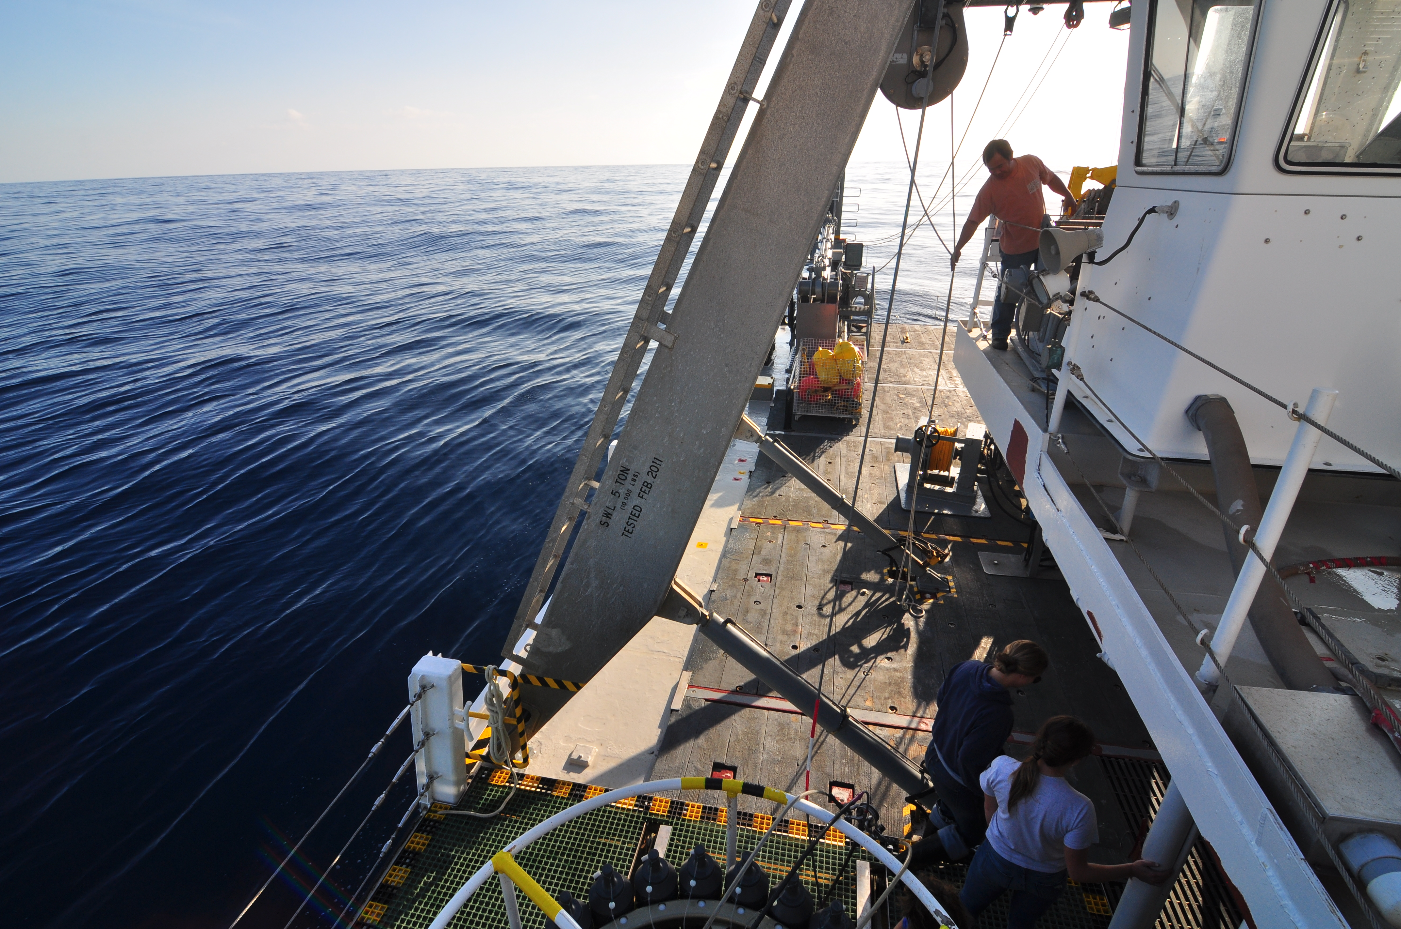
What reads are we classifying today?
We have 21 (paired-end) marine metagenomes
from BATS - Bermuda Atlantic Time Series
Oligotrophic surface ocean 2003 - 2009, 1m & 10m.
Prep:
Downloaded fastq from SRA
E.g. SRR5720233_1.fastq.gz
SRR5720233_2.fastq.gz
Down-sampled each fastq to 1 million reads.
Reformatted SeqIDs so forward and reverse match
(described in setup_classifier.ipynb)
We can classify these all at once!

Slide 27
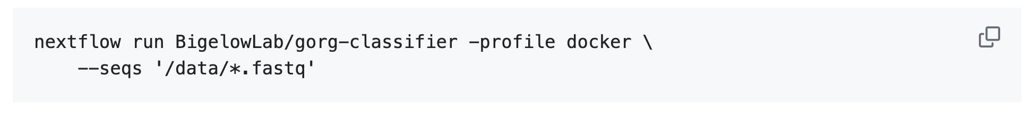
Classifier command
From the ReadMe

Slide 28
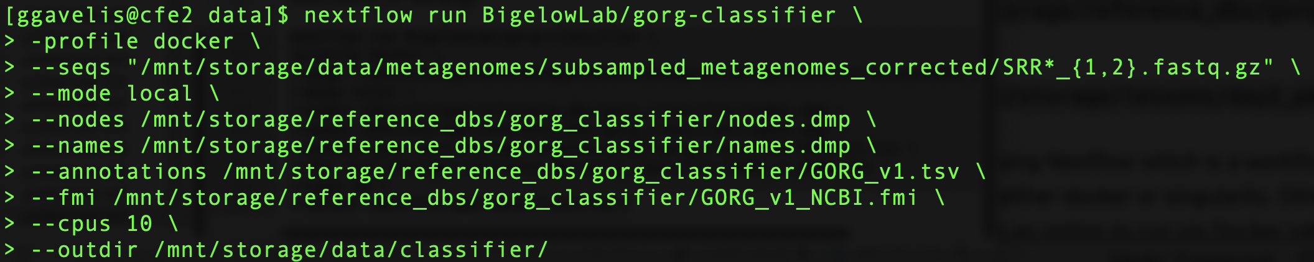
Today’s command:
Runs nextflow script hosted
on Bigelow’s github
Notes:
nextflow run BigelowLab/gorg-classifier \
-profile docker \
--seqs "/mnt/storage/data/metagenomes/subsampled_metagenomes_corrected/SRR*_{1,2}.fastq.gz" \
--mode local \
--nodes /mnt/storage/reference_dbs/gorg_classifier/nodes.dmp \
--names /mnt/storage/reference_dbs/gorg_classifier/names.dmp \
--annotations /mnt/storage/reference_dbs/gorg_classifier/GORG_v1.tsv \
--fmi /mnt/storage/reference_dbs/gorg_classifier/GORG_v1_NCBI.fmi \
--cpus 10 \
--outdir /mnt/storage/data/classifier/

Slide 29
Today’s command:
Telling it to use docker to run dependencies
Notes:
nextflow run BigelowLab/gorg-classifier \
-profile docker \
--seqs "/mnt/storage/data/metagenomes/subsampled_metagenomes_corrected/SRR*_{1,2}.fastq.gz" \
--mode local \
--nodes /mnt/storage/reference_dbs/gorg_classifier/nodes.dmp \
--names /mnt/storage/reference_dbs/gorg_classifier/names.dmp \
--annotations /mnt/storage/reference_dbs/gorg_classifier/GORG_v1.tsv \
--fmi /mnt/storage/reference_dbs/gorg_classifier/GORG_v1_NCBI.fmi \
--cpus 10 \
--outdir /mnt/storage/data/classifier/

Slide 30
Today’s command:
Inputting the paired read files
Notes:
nextflow run BigelowLab/gorg-classifier \
-profile docker \
--seqs "/mnt/storage/data/metagenomes/subsampled_metagenomes_corrected/SRR*_{1,2}.fastq.gz" \
--mode local \
--nodes /mnt/storage/reference_dbs/gorg_classifier/nodes.dmp \
--names /mnt/storage/reference_dbs/gorg_classifier/names.dmp \
--annotations /mnt/storage/reference_dbs/gorg_classifier/GORG_v1.tsv \
--fmi /mnt/storage/reference_dbs/gorg_classifier/GORG_v1_NCBI.fmi \
--cpus 10 \
--outdir /mnt/storage/data/classifier/

Slide 31
Today’s command:
Inputting the paired read files
Files begin with “SRR” end with “.fastq.gz”
Forward/Reverse named with “1”/“2” respectively
Notes:
nextflow run BigelowLab/gorg-classifier \
-profile docker \
--seqs "/mnt/storage/data/metagenomes/subsampled_metagenomes_corrected/SRR*_{1,2}.fastq.gz" \
--mode local \
--nodes /mnt/storage/reference_dbs/gorg_classifier/nodes.dmp \
--names /mnt/storage/reference_dbs/gorg_classifier/names.dmp \
--annotations /mnt/storage/reference_dbs/gorg_classifier/GORG_v1.tsv \
--fmi /mnt/storage/reference_dbs/gorg_classifier/GORG_v1_NCBI.fmi \
--cpus 10 \
--outdir /mnt/storage/data/classifier/

Slide 32
Today’s command:
Inputting the paired read files
Files begin with “SRR” end with “.fastq.gz”
Forward/Reverse named with “1”/“2” respectively
Notes:
nextflow run BigelowLab/gorg-classifier \
-profile docker \
--seqs "/mnt/storage/data/metagenomes/subsampled_metagenomes_corrected/SRR*_{1,2}.fastq.gz" \
--mode local \
--nodes /mnt/storage/reference_dbs/gorg_classifier/nodes.dmp \
--names /mnt/storage/reference_dbs/gorg_classifier/names.dmp \
--annotations /mnt/storage/reference_dbs/gorg_classifier/GORG_v1.tsv \
--fmi /mnt/storage/reference_dbs/gorg_classifier/GORG_v1_NCBI.fmi \
--cpus 10 \
--outdir /mnt/storage/data/classifier/

Slide 33
Today’s command:
local means we’ll give it paths to local reference databases and config files
Notes:
nextflow run BigelowLab/gorg-classifier \
-profile docker \
--seqs "/mnt/storage/data/metagenomes/subsampled_metagenomes_corrected/SRR*_{1,2}.fastq.gz" \
--mode local \
--nodes /mnt/storage/reference_dbs/gorg_classifier/nodes.dmp \
--names /mnt/storage/reference_dbs/gorg_classifier/names.dmp \
--annotations /mnt/storage/reference_dbs/gorg_classifier/GORG_v1.tsv \
--fmi /mnt/storage/reference_dbs/gorg_classifier/GORG_v1_NCBI.fmi \
--cpus 10 \
--outdir /mnt/storage/data/classifier/

Slide 34
Today’s command:
Taxonomy
local means we’ll give it paths to local reference databases and config files
Annotations
Kaiju index
Notes:
nextflow run BigelowLab/gorg-classifier \
-profile docker \
--seqs "/mnt/storage/data/metagenomes/subsampled_metagenomes_corrected/SRR*_{1,2}.fastq.gz" \
--mode local \
--nodes /mnt/storage/reference_dbs/gorg_classifier/nodes.dmp \
--names /mnt/storage/reference_dbs/gorg_classifier/names.dmp \
--annotations /mnt/storage/reference_dbs/gorg_classifier/GORG_v1.tsv \
--fmi /mnt/storage/reference_dbs/gorg_classifier/GORG_v1_NCBI.fmi \
--cpus 10 \
--outdir /mnt/storage/data/classifier/

Slide 35
Today’s command:
Notes:
nextflow run BigelowLab/gorg-classifier \
-profile docker \
--seqs "/mnt/storage/data/metagenomes/subsampled_metagenomes_corrected/SRR*_{1,2}.fastq.gz" \
--mode local \
--nodes /mnt/storage/reference_dbs/gorg_classifier/nodes.dmp \
--names /mnt/storage/reference_dbs/gorg_classifier/names.dmp \
--annotations /mnt/storage/reference_dbs/gorg_classifier/GORG_v1.tsv \
--fmi /mnt/storage/reference_dbs/gorg_classifier/GORG_v1_NCBI.fmi \
--cpus 10 \
--outdir /mnt/storage/data/classifier/

Slide 36
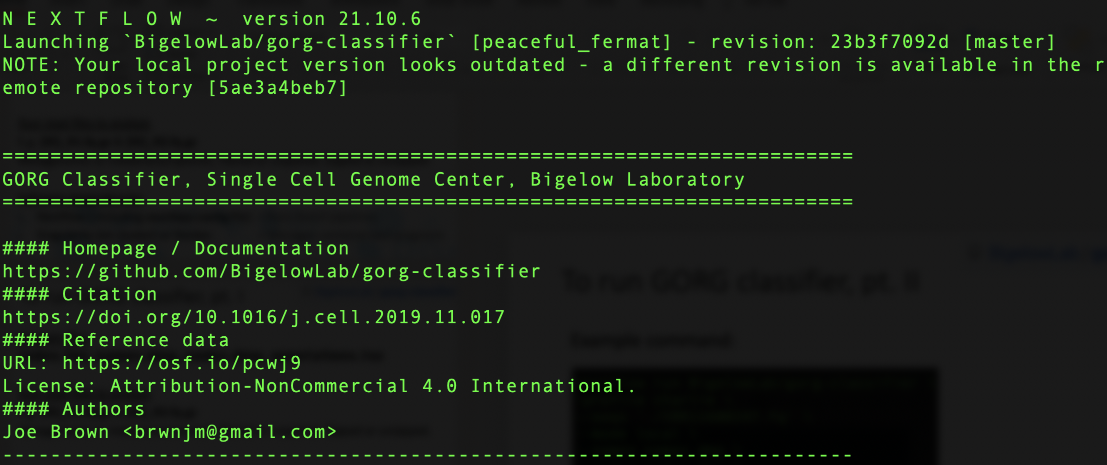
Now it’s running ....

Slide 37
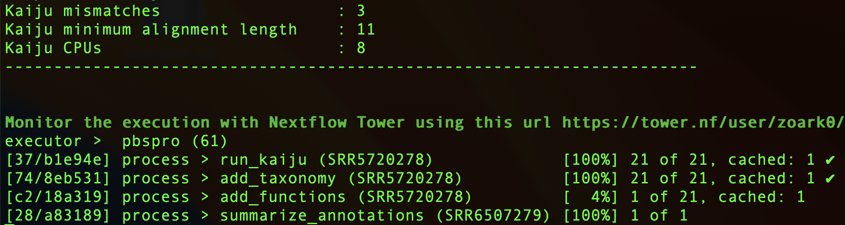
Now it’s running …
View on seqera:
(a web interface for monitoring nextflow runs)
Notes:
It prints the default settings of Kaiju, which is to allow 3 mismatches per protein alignment, and a minimum length of 11 amino acids.
Notice also that I never had to install kaiju, nextflow got singularity to install a cointainer of kaiju for me.
Only the first step is running Kaiju, and the 2nd through 4th steps of the pipeline are Joe’s programs being run from github. These hashes refer to local working directories that nextflow makes automatically to encapsulate each step of the pipeline.

Slide 38
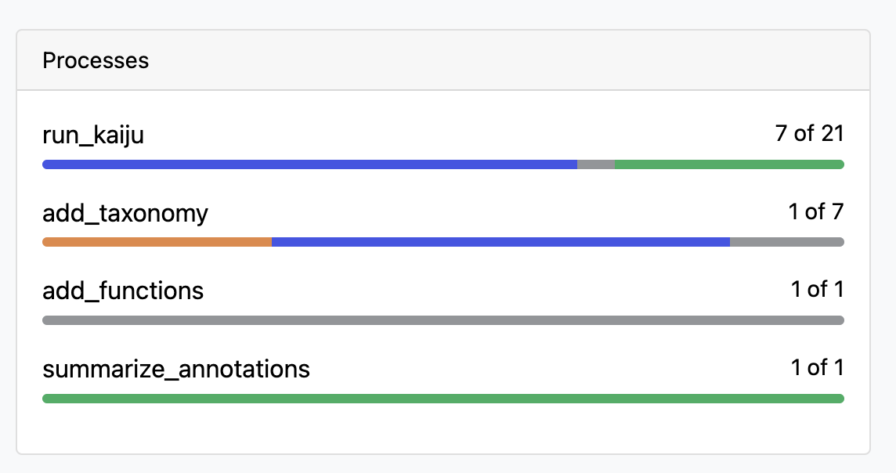
Now it’s running …
View on seqera:
(a web interface for monitoring nextflow runs)
Notes:
It prints the default settings of Kaiju, which is to allow 3 mismatches per protein alignment, and a minimum length of 11 amino acids.
Notice also that I never had to install kaiju, nextflow got singularity to install a cointainer of kaiju for me.
Only the first step is running Kaiju, and the 2nd through 4th steps of the pipeline are Joe’s programs being run from github. These hashes refer to local working directories that nextflow makes automatically to encapsulate each step of the pipeline.

Slide 39
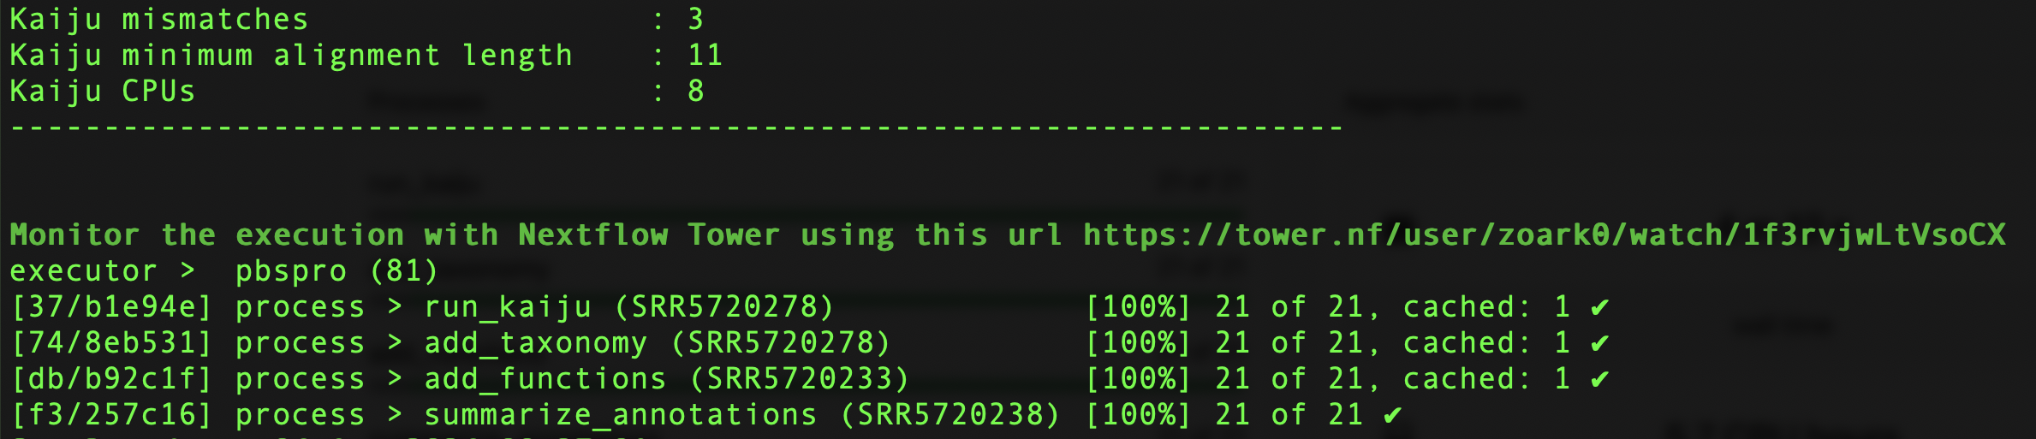
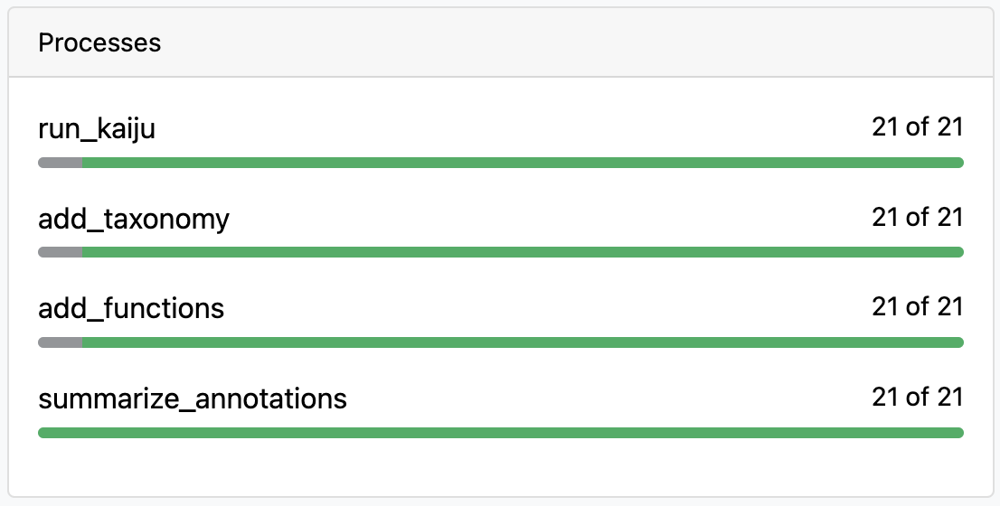
Now it’s done!
View on seqera:
(a web interface for monitoring nextflow runs)
Notes:
It prints the default settings of Kaiju, which is to allow 3 mismatches per protein alignment, and a minimum length of 11 amino acids.
Notice also that I never had to install kaiju, nextflow got singularity to install a cointainer of kaiju for me.
Only the first step is running Kaiju, and the 2nd through 4th steps of the pipeline are Joe’s programs being run from github. These hashes refer to local working directories that nextflow makes automatically to encapsulate each step of the pipeline.

Slide 40
Let’s explore the results!
Copy over this lesson’s jupyter notebook:
/mnt/storage/lessons/day2_pm_classifier/classifier.ipynb
To your userlab directory

Slide 41

Notes about Nextflow
Learning curve: Yes, Nextflow is more involved than writing a pipeline in bash. Takes some time to learn, but less so to run other people’s pipelines.
Nice tutorial:
https://carpentries-incubator.github.io/workflows-nextflow/index.html
Singularity to run on a cluster: Consult with your system administrator about installing Singularity if you need to use it on a cluster. (Or just use Docker if you’re running on a personal machine).

Slide 42
Advantages of nextflow
Safer than running pipelines in bash (E.g. can’t delete your own file system).
More flexible than Snakemake or other bioinf’ pipeline languages.
Portability: it installs & runs containerized programs for you.
Efficiency: It saves time/energy by never rerunning steps that were successful.

